Slide 1
NW Three-Year Assessment: What is it and why (do we do it?)
Measuring the Capacity, Performance, and Impact of NeighborWorks Network Members
Notes:
Refer to last onsite review findings and findings from the last off-site PRO review to discuss outstanding findings and area for focus

Slide 2
Why does NW do an assessment?
Ensure we are meeting one of our own FY22 – FY24 strategic plan goals: Strengthen the capacity and sustainability of the NW network.
Enhance the performance, productivity and operational resiliency of network organizations.
Ensure that network organizations meet membership standards and performance objectives.
Ensure compliance with NeighborWorks America contracts and network standards and P.S. We report to Congress!

Slide 3
Assessment Phases
Confirm availability. Check. Mia Joiner-Moore is your reviewer. Lucky. You!
Discovery
NWWVT’s onsite or remote assessment is April 12 - 14
A draft and final report

Slide 4
Program Review: PROMPT
NW has a uniform program review system that is based on evaluating performance and capacity in six key areas. We call it “PROMPT.”
PROMPT is the answer to what is it (the assessment) question. ”

Slide 5
What is PROMPT?
PRODUCTION/PROGRAM SERVICES
Evaluates production, impact, and quality of each line of business
RESOURCE & FINANCIAL MANAGEMENT
Evaluates financial health, resource development & management, and financial management/accounting systems & procedures
ORGANIZATIONAL MANAGEMENT & **BOARD GOVERNANCE** Evaluates corporate, board, committees/task groups and affiliated partnerships

Slide 6
More PROMPT
MANAGEMENT
Evaluates staffing and personnel management
PLANNING
Evaluates multi-year strategic and annual operational planning/community development
TECHNICAL OPERATING & COMPLIANCE SYSTEMS
Evaluates service delivery procedures, client & contract management, and compliance systems

Slide 7
After the assessment and the final report comes the OHTS Committee
Organizational Health Tracking System (OHTS) meets quarterly
Officers and senior leadership of NW
Includes related capital corporations as non-voting members
Cross-divisional risk assessment discussions
All NWO ratings are assessed annually, informed by annual off-site PRO reviews or three-year PROMPT reviews.

Slide 8
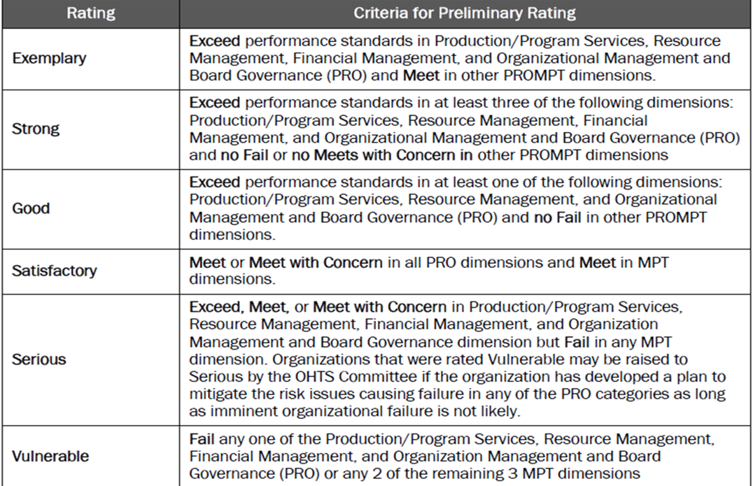
Notes:
Previous 4-point system included Exemplary, Strong, Satisfactory, and Vulnerable (Good and Serious are new)
NWO ratings are updated to the 6-point system as onsite and off-site PRO reviews occur

Slide 9
Here’s my advice. Some cool things can happen….
Use the assessment as an opportunity to learn about yourselves as Board members and NWWVT as an organization. Mia will ask you some really interesting questions.
Take away best practices. Sometimes you don’t have to reinvent the wheel!
Be curious about what other network groups are doing. Will it work in VT?
Be an informed ambassador. If you were in EIG—let your light shine!

Slide 10
Cool things will happen but you need to be prepared!
Homework is your friend. Review the 3 documents that Jen provided. Everything is there! What question(s) scares you the most? Answer it for practice.
Be familiar with your mission and vision statements and be able to describe how your work as a Board member supports them.
Yay! You have a brand, spanking new strategic plan! Know what direction are you going in. Why is it important that you base your collective work on the strategic plan?

Slide 11
This is the last slide, I swear….
Be able to talk about what you (the board and NWWVT) do well and what your challenges are. Talk about how you are going to address challenges head on.
Q: What are you going to do to grow the board? A: _________________.
What makes you proud of NWWVT? Why?
How much do you understand NWWVT’s LOB and the financials?
Why do you use dashboards? When was the last board self-assessment? When is Heather’s annual review?
Are you on a board committee? What do you do? Do you have a committee description? (Trick question ☺)
Why are YOU on the board?

